Slide 1
IBM Coursera Capstone
Toronto Business Classification
By
Belachew Ayele
January 2021

Slide 2
Outline
    Introduction
    Business Problem
    Data Sources
    Data Integration
    Analysis
    Finding/Result
    Conclusion
    Reference

Slide 3
Introduction
This is a project of IBM Data Science Capstone
Focus on concluding practices of Data science
Data cases is Toronto Area

Slide 4
Business Problem
Learn and practice how to use Foursquare on Toronto City
Classify businesses of Toronto city and surrounding
How data science and foursquare API are used for clustering
Neighborhood data
Learn more about Data Science

Slide 5
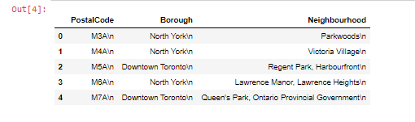
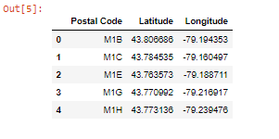
Data Sources
Three data source
Strat data
Start data = ‘https://en.wikipedia.org/wiki/List_of_postal_codes_of_Canada:_M’
Geo Data
geo_data = ‘https://cocl.us/Geospatial_data’

Slide 6
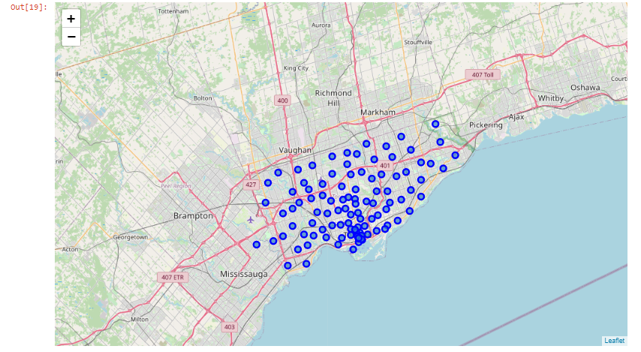
Toronto Map with Records

Slide 7
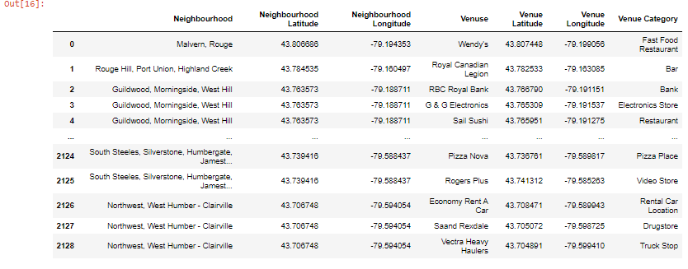
Foursquare Data

Slide 8
Data Integration
Merging data
    Grouping and transferring features
Slicing data
    Extracting data

Slide 9
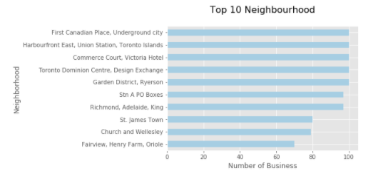
Data Analysis
Top 10 Neighborhood with number of venues/business

Slide 10
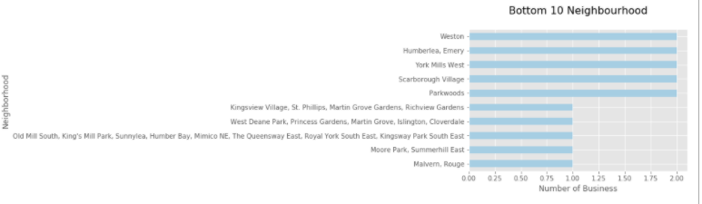
Data Analysis
Bottom 10 Neighborhood with number of venues/business

Slide 11
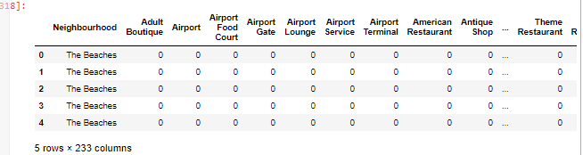
Data Analysis/Clustering
Onehot
Partial view of data frame

Slide 12
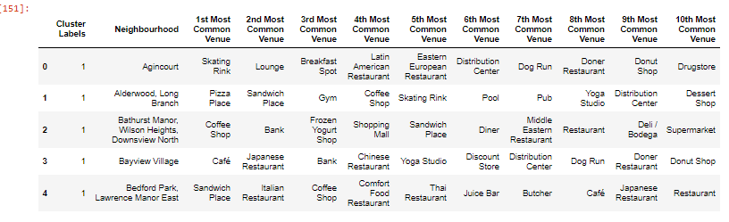
The 10 Most common venues in each Neighborhood

Slide 13
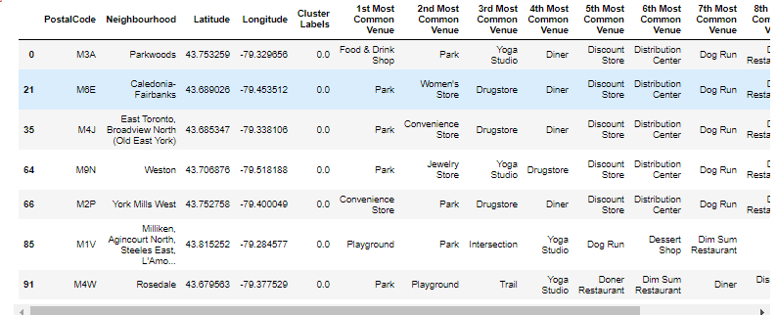
Clustering data
Cluster label 1

Slide 14
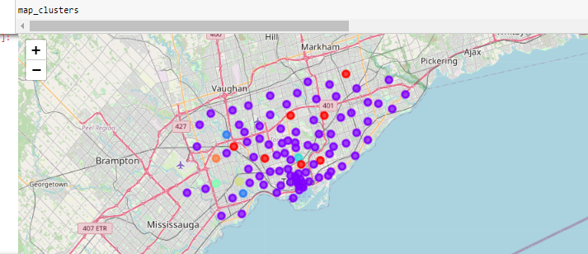
Finding/Result
Toronto Neighborhood data Clustered in to 7 classes

Slide 15
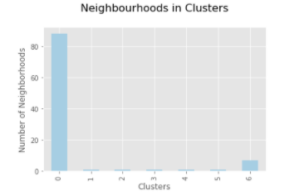
Conclusion
Number of Neighborhood in each cluster
Cluster | Number of Neighborhoods | Some of the Common Venues in cluster
0 | 88 | Bars, Coffee Shops, Pizza Places
1 | 1 | Fast Food Restaurant, Yoga Studio
2 | 1 | Martial Arts School, Electronic Store
3 | 1 | Baseball Field, Dog Run
4 | 1 | Filipino Restaurant, Eastern European Restaurant
5 | 1 | Pizza Places
6 | 7 | Playground, Parks,

Slide 16
Reference
List of postal codes of Canada: M
en.wikipidia.org ---- (visited on December 2020)
https://en.wikipedia.org/wiki/List_of_postal_codes_of_Canada:_M
List of postal code from online ---- (visited on December 2020)
https://cocl.us/Geospatial_data
Several IBM data science notes and lectures from the IBM Coursera class

